Slide 1
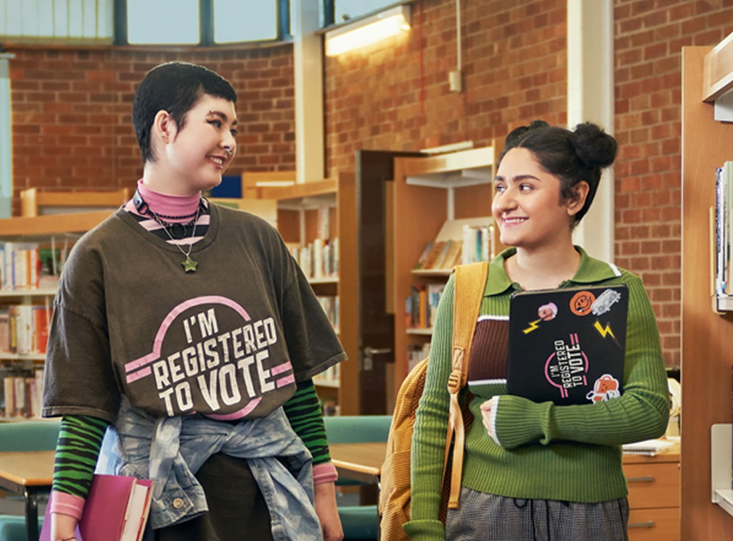

We’re registered to vote, are you?
Launch
Launch
… and what does that mean, anyway?
Notes:
Welcome to our electoral registration presentation, prepared by the Electoral Registration Office for Clackmannanshire, Falkirk, and Stirling Councils.
This presentation has been designed as an assembly or to be split into 3 parts at slides 11 and 23 and accompanying worksheets have been provided.
Where further information may be needed, notes have been provided in the slideshow notes to assist with FAQs or give background information for educators.
We hope you find this resource useful and would love to hear your feedback.

Slide 2
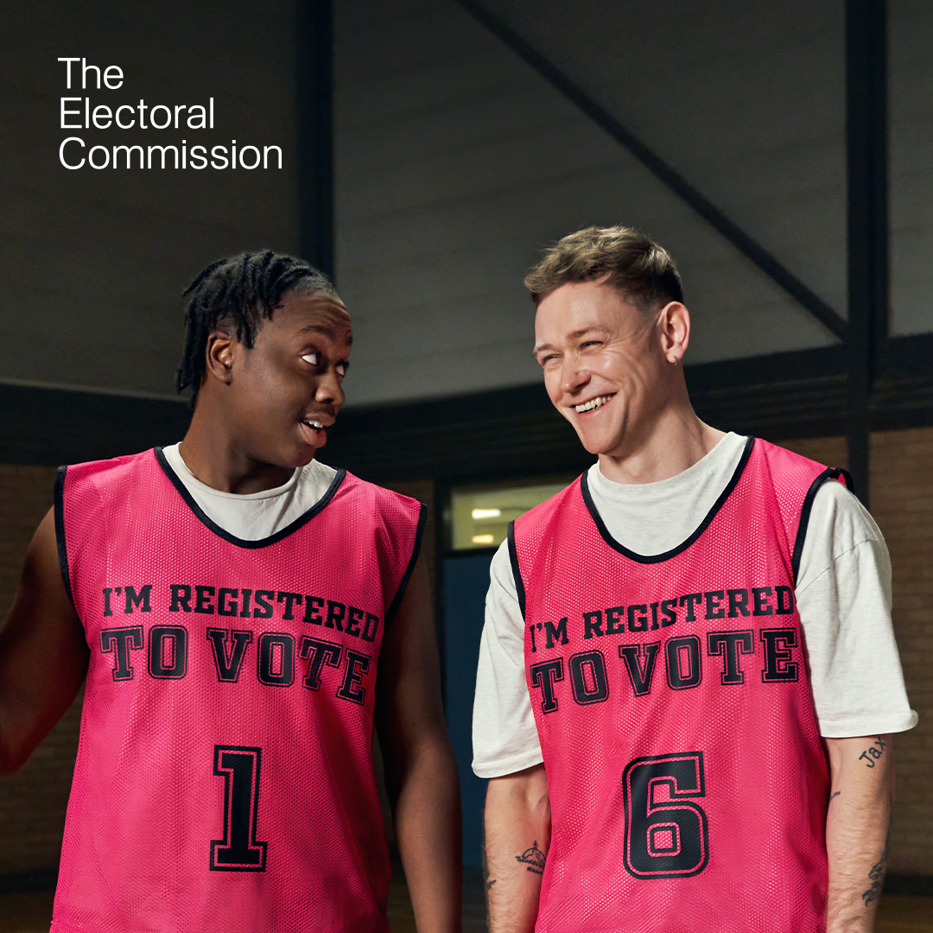
Registering to vote
BOFFIN
FUNKY TUNES
Watch the video then answer the questions:

Slide 3
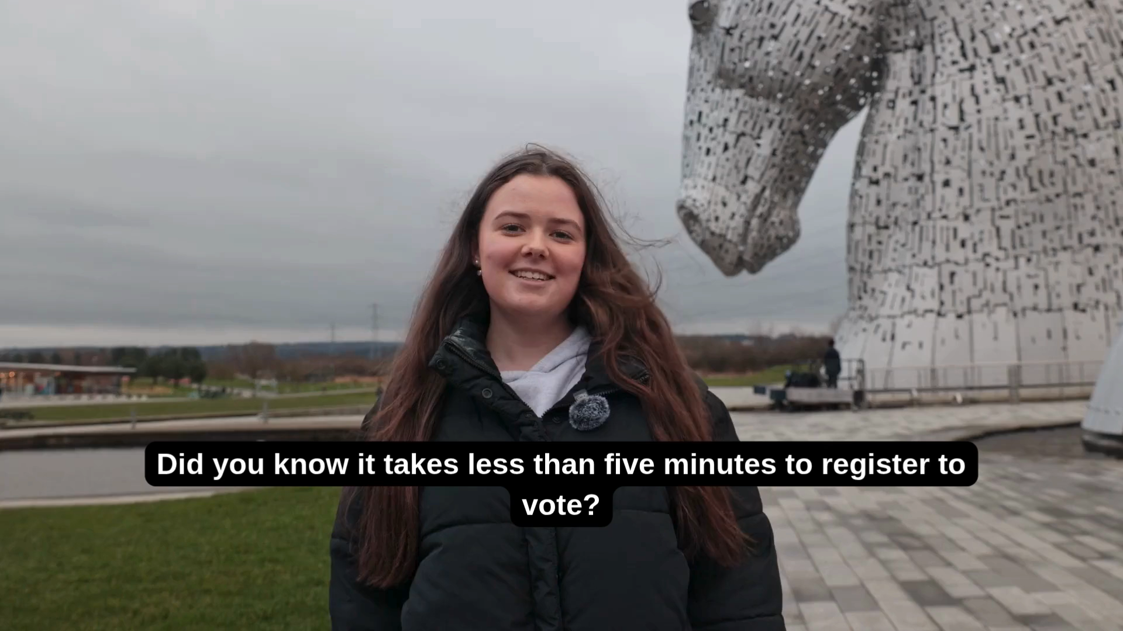

Notes:
This video was filmed in 2025 in conjunction with local MSYPs for Clackmannanshire, Falkirk, and Stirling council areas. The young people met to work on the script and to decide on local landmarks to represent their council areas.

Slide 4
How old do you have to be to register to vote?
14
16
18
Notes:
The minimum age to register is 14 years old. The Electoral Office sends out Invitation to Register (ITR) forms to all young people who we know have turned 14 once a year, so some young people may already have been invited to register.

Slide 5

How old do you have to be to register to vote?
You can register to vote from the age of 14. You might receive an application form in the post.
You won’t be able to vote for a while, but it means you have plenty of time to get registered before you turn 16 – that way you could vote if an election happened on your birthday.
It’s important to register in advance because the electoral register is only updated once a month, so leaving it to the last minute could mean you miss out.
14
16
18
Notes:
The electoral register is updated once a month, but there is also an extra deadline of midnight, 12 working days prior to an election. Leaving registration to the last-minute means that there is no time to correct mistakes, and if there is a problem with an application, there may not be time to fix this prior to the election.
It can also mean that the choice of voting method may be restricted, as the postal vote application deadline is 5pm the day after the registration deadline. In the 2024 UK Parliamentary General Election, many people who applied for a postal vote close to the deadline were disappointed because they applied too late.

Slide 6
What % of young people in Central Scotland are not on the electoral register?
>20%
>30%
>40%
Notes:
Older people are much more likely to be registered than young people, with only just over two-thirds of young people being registered to vote in 2022 (most recent Electoral Commission data Explore the data: Who is and isn't registered to vote? | Electoral Commission) but over 90% of people over 55.

Slide 7
What % of young people in Central Scotland are not on the electoral register?
Around 30% of young people in our area aren’t registered to vote.
That means almost a third of young people would not be able to have their say if an election were called.
You can’t register to vote on the day of the election; you must do it in advance. Each election has a deadline, but you can register to vote at any time. Once you’ve registered, you don’t have to do it again unless you move home or change your name.
20%
30%
40%
Notes:
If someone changes their name, they can apply to us for a change of name form, or they can make a new application in their new name.
If they use a change of name form, we need to see evidence of the name change e.g. deed poll, marriage certificate. If they apply again, there is an option to provide a previous name. We understand that there are reasons why someone may not wish to give their previous name, but it does help us to remove their old name from the register and stop letters/poll cards being sent out in the wrong name. It also lets us know that they aren’t two separate people with the same date of birth.
If someone under 18 has changed their name at school, we may be able to verify the name change using school data, so a new application in the new name may be best.

Slide 8
How long does it take to register to vote?
20 mins
10 mins
5 mins

Slide 9
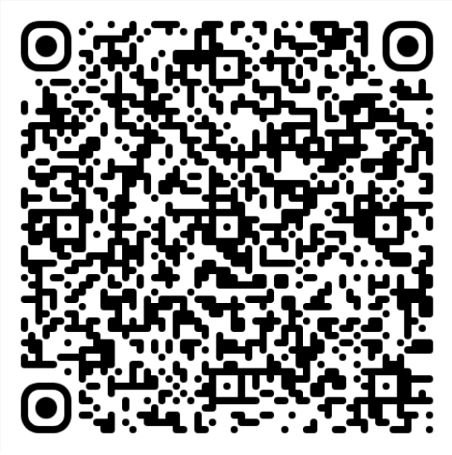
How long does it take to register to vote?
It only takes 5 mins to register to vote.
You might receive an Invitation to Register (ITR) form in the post, but you do not need to wait for this.
You can register online at www.gov.uk/register-to-vote
20 mins
10 mins
5 mins

Slide 10
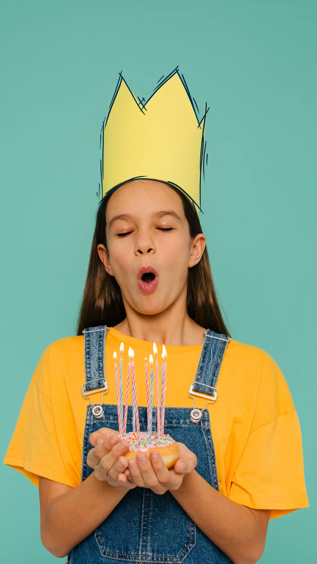
Your democracy timeline
The minimum age someone can register to vote.
The age someone can vote in local council and Scottish Parliament elections.
The age someone can vote in UK parliament elections.
14
16
18

Slide 11
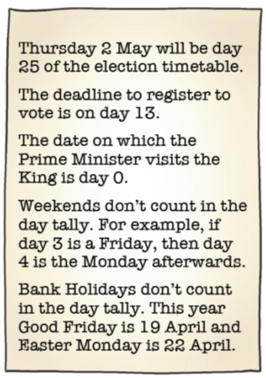
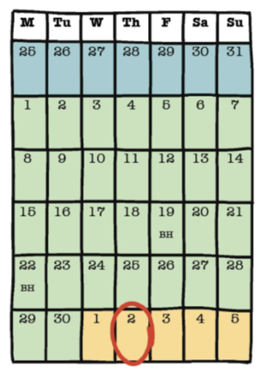
Why register to vote if there is no election?
There is a deadline to register!
On Tuesday the 26th of March, the Prime Minister calls an unexpected General election.
The election will happen on Thursday the 2nd of May. There is a special 25-day election timetable. Events happen on specific days.
Anyone who is not registered before midnight on the deadline date will not be able to vote.
Use the clues to work out the deadline to register to vote for this election.
Notes:
There is a worksheet handout in the pack which corresponds with this slide. It could be beneficial to reinforce the benefits of registering to vote when there hasn’t been an election called, e.g. this 25-day timetable covers school holidays, several religious festivals, and prelims/exam preparation time, which means registering to vote could be a lesser priority and people could accidentally miss out.

