Slide 1
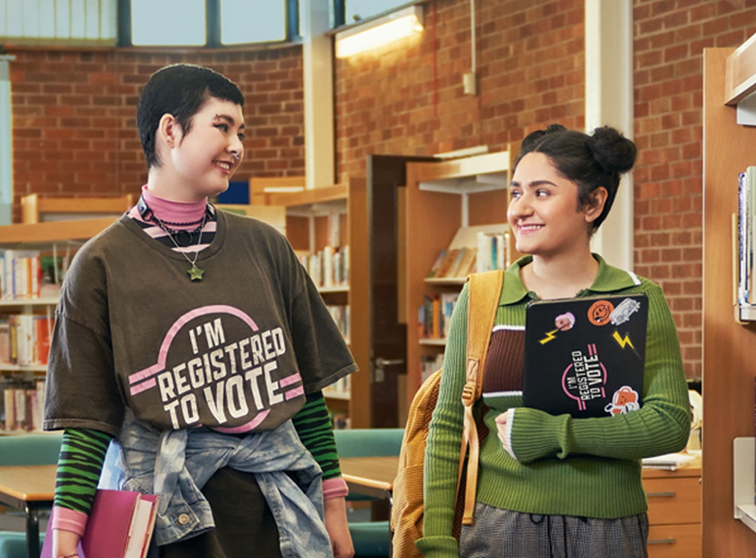

We’re registered to vote, are you?
Launch
Launch
… and what does that mean, anyway? Lesson 2
Notes:
Welcome to our electoral registration presentation, prepared by the Electoral Registration Office for Clackmannanshire, Falkirk, and Stirling Councils. This presentation has been designed as an assembly or to be split into 3 parts at slides 11 and 23 and accompanying worksheets have been provided. Where further information may be needed, notes have been provided in the slideshow notes to assist with FAQs or give background information for educators. We hope you find this resource useful and would love to hear your feedback.

Slide 2

Democracy in Scotland
Scotland is part of the UK but there’s a Scottish Parliament too, what does this mean?
The UK Parliament is based in the Houses of Parliament in Westminster, London.
On the 1st of July 1999, the Scottish Parliament opened, transferring some powers from the UK government in a process known as devolution.
The Scottish Parliament – which is based in Holyrood, Edinburgh - makes decisions about many aspects of life in Scotland, such as education, the environment, and health and social care.
Some decisions are still made by the UK Parliament, such as decisions around defence and immigration.
Local issues like rubbish collection, leisure, and roads & transport, are decided by local councils.
Notes:
This slide can be used for further discussion on the different types of elections and what Devolution means. Our MSYP consultation revealed that many young people are put off voting because they don’t understand the voting processes.
The Electoral Commission has some good short videos which explain the different elections and how they work here: Local Councils (single transferrable vote): https://www.electoralcommission.org.uk/resources/resources-young-people/who-responsible/local-councils/how-councillors-are-elected
How councillors are elected | Electoral Commission
Scottish Parliamentary Elections (proportional representation):
https://www.electoralcommission.org.uk/resources/resources-young-people/who-responsible/scottish-parliament
Scottish Parliament | Electoral Commission
UK Parliamentary Elections (first past the post): https://www.electoralcommission.org.uk/resources/resources-young-people/who-responsible/uk-parliament UK Parliament | Electoral Commission

Slide 3
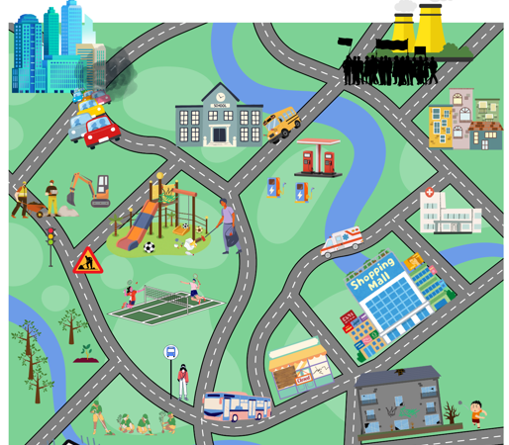
How does politics affect me?
Discuss the issues and initiatives in this fictional town. How might they affect the residents, and what can residents do to make changes?
Notes:
Some issues might be: pollution and traffic from the city, roadworks, litter and graffiti in the parks, protests at the power station, small shops closing in favour of large retail parks/supermarkets, vandalism, sub-standard housing.
Some initiatives pictured are free bus travel, education, NHS, new social housing, investment in leisure (badminton courts), installation of EV charging stations, planting new trees by the riverbank, litter-picking.
The residents could volunteer to litter-pick or plant trees etc. They could write to their councillor or MP/MSP about an issue, they could sign a petition, join a protest, they could register to vote so that they can elect someone who represents their views.

Slide 4
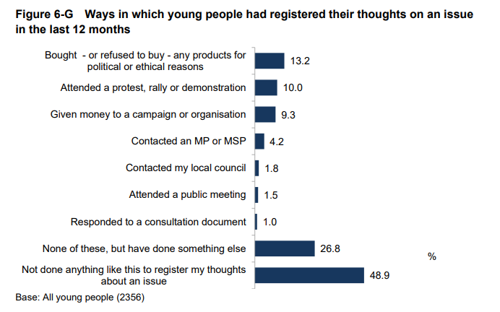
The graph on the right shows ways that young people in Scotland had registered their thoughts on an issue in the 12 months prior to 2023. It is taken from the Life at age 17: initial findings from the Growing Up in Scotland study (Sweep 11).
How did your answers from the previous slide compare?
Have you done any of these things?

Slide 5
What can I vote in?
UK Parliament Elections
You must be 18 or over and a British citizen, or a citizen of a qualifying Commonwealth country.
Scottish Parliament Elections
You must be 16 or over and be resident in Scotland, no matter your nationality.
Local Council Elections
You must be 16 or over and be resident in Scotland, no matter your nationality.
Full time students who are living away from home during term time e.g. at university, are allowed to register at their term time address if they wish, as well as their home address, if they only vote in one location. This means students can participate in local elections at their term time address, so they can have a say on local issues.
Notes:
The gov.uk website gives the option to select “student” which means the person won’t be removed from their previous address if they provide it.

Slide 6

Let’s look at some examples and see if we can figure out which elections some fictional pupils would be eligible to vote in…
Notes:
The following slides show a map of the UK with some details about imaginary pupils. A click will reveal an outline of the areas the person is eligible to vote in, and an explanation will appear at the right-hand side. If they are eligible to vote in Scotland, it is outlined in blue, UK in orange, and if they can vote in all elections, it will show both outlines.
An accompanying worksheet has been provided if this is to be used as a class activity rather than an assembly. The example pupils and explanations are the same.

Slide 7
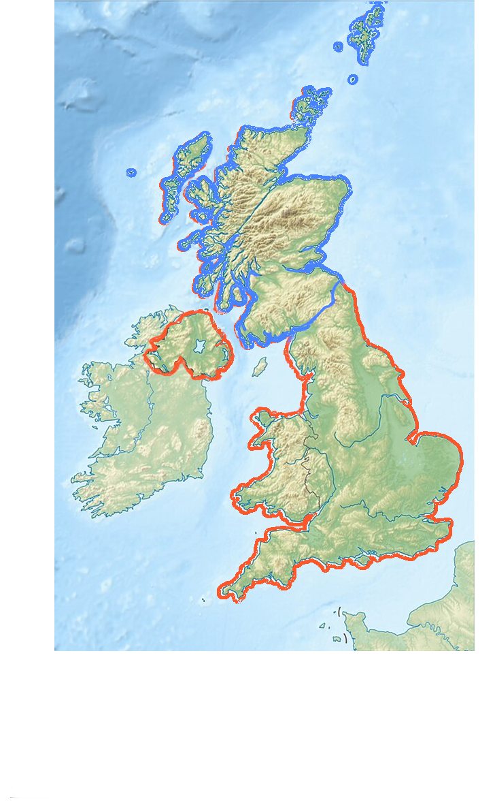
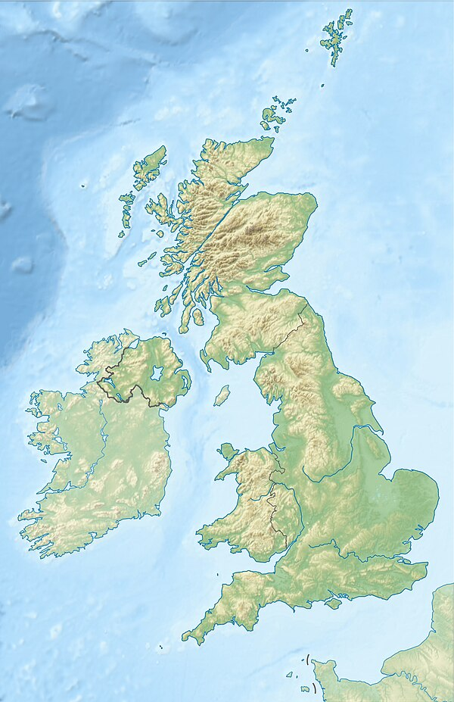
Pupil A is over 16 and lives in Scotland, so they are eligible to vote in Scottish Parliamentary and local government elections.
They are over 18 and are a citizen of a qualifying Commonwealth country, so they can also vote in UK Parliamentary elections.
Pupil A Age: 18 Nationality: Nigerian
Lives in Alloa
This Photo by Unknown Author is licensed under CC BY-SA

Slide 8
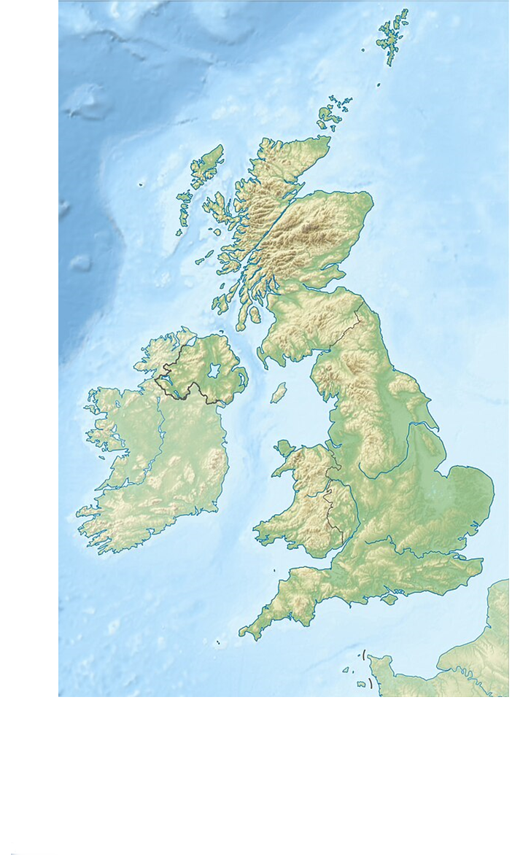
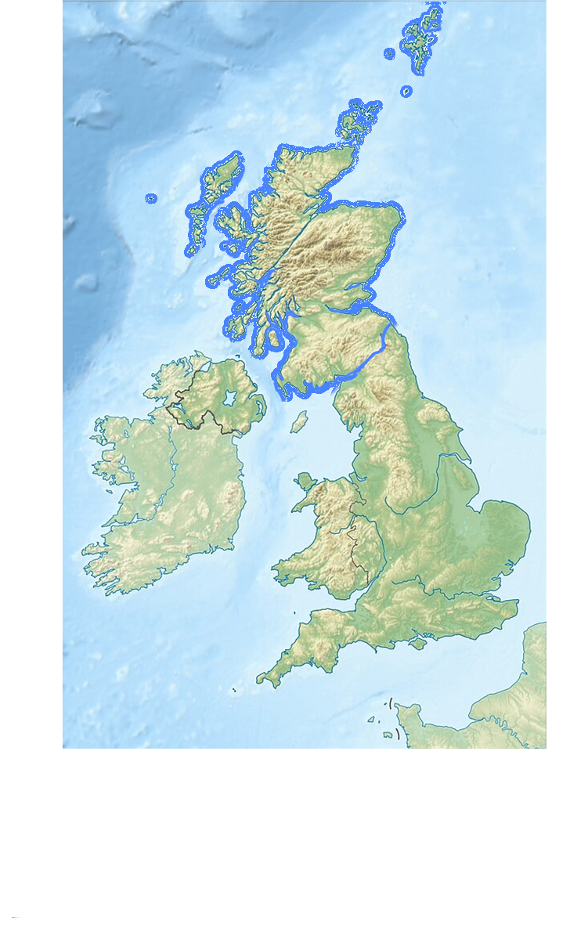
Pupil B is over 16 and lives in Scotland, so they are eligible to vote in Scottish Parliamentary and local government elections.
They are under 18 so can’t vote in UK Parliamentary elections yet, but as they are a UK citizen, they will be able to vote in this type of election once they turn 18.
Pupil B Age: 16 Nationality: British
Lives in Stirling

Slide 9
Pupil C is over 16 and lives in Scotland, so they are eligible to vote in Scottish Parliamentary and local government elections.
They are under 18 so they are not eligible to vote in UK Parliamentary elections, and due to their nationality, they will not be able to vote in this type of election once they turn 18.
Pupil C Age: 16 Nationality: Polish
Lives in Falkirk

Slide 10
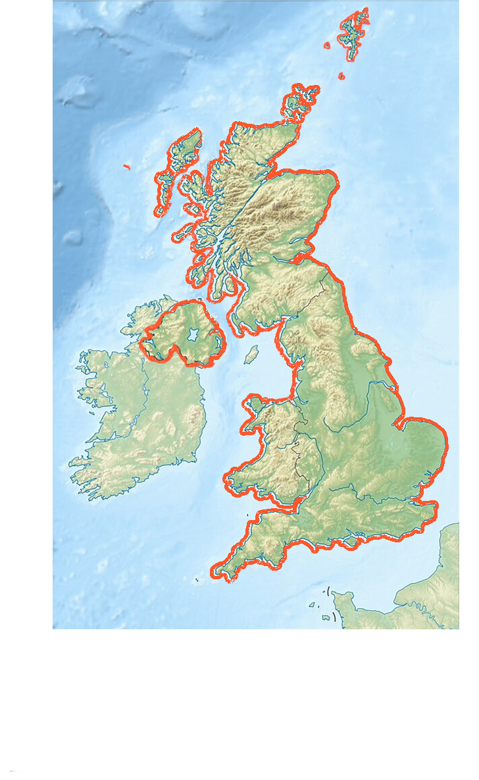
Pupil D is over 16 but no longer lives in Scotland, so they are not eligible to vote in Scottish Parliamentary and local government elections.
They are over 18 and are a UK citizen, so they can still vote in UK Parliamentary elections, but to do so, they must register to vote again, this time as a special category of elector called an overseas elector.
Pupil D Age: 18 Nationality: British
Has just moved to Germany
Notes:
If someone lives overseas, they must register as an “overseas elector” and will be invited regularly to renew this application. They are encouraged to set up an absent voting method, either by post or by proxy. They cannot vote in local council or Scottish Parliament elections.

Slide 11

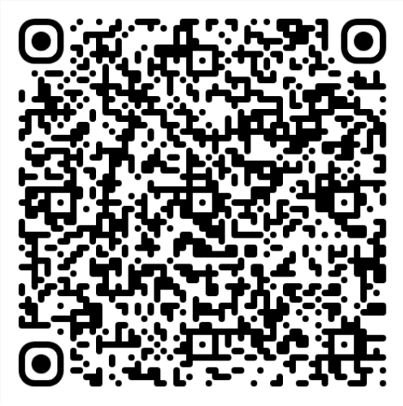

How to register
It takes 5 minutes, and you can do it online at www.gov.uk/register-to-vote
If you don’t have your national insurance number yet, you can still register.
The electoral office will contact you if they need more information.
The electoral office keeps your data safe in line with GDPR.
When you turn 16, your name will be added to the electoral register, and you will be able to vote in some elections right away.
You can register to vote if you live in Scotland, no matter your nationality.
You need to register to vote each time you move house or change your name, but you don’t need to do it for every election.
Notes:
.

