Slide 1
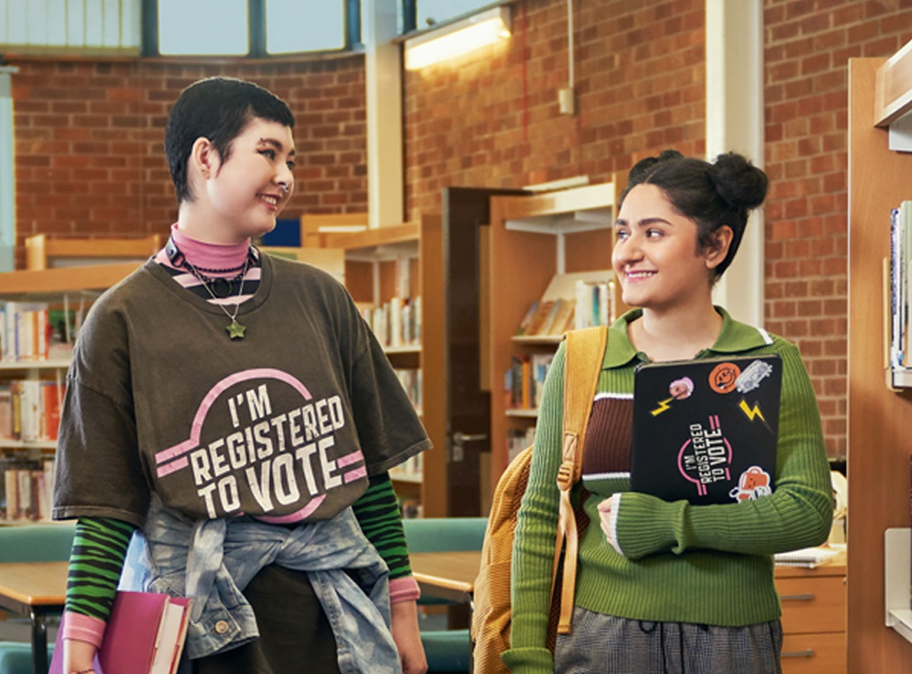

We’re registered to vote, are you?
Launch
Launch
… and what does that mean, anyway? Lesson 3

Slide 2


Let’s dispel some common myths about registering to vote!
I can’t register to vote! The form asks for your National Insurance number, and I don’t have one yet!
If you are under 16, you don’t need to provide one. If the Electoral Registration Office need information to prove your identity, they will contact you and let you know exactly what they need, and you can send documents by email.
Notes:
The electoral office can verify the ID of young people who attend school using school data. Occasionally, we may need to ask for documentation. The usual things would be a passport, or a birth certificate and pieces of addressed mail. In circumstances where the person doesn’t have documentation, a person of good standing in the community, e.g. a teacher, can provide an attestation to confirm the applicant’s identity. The person completing the attestation must be registered to vote.

Slide 3
Let’s dispel some common myths about registering to vote!
I can’t register to vote! I’m not British.
You don’t need to be a British Citizen to register to vote. Anyone resident in Scotland can vote in Scottish Parliament and local elections. Some Commonwealth citizens can vote in UK Parliament elections too.
Notes:
Commonwealth citizens must have leave to remain in the UK. Citizens of Cyprus and Malta are also eligible to vote in UK parliamentary elections.

Slide 4
Let’s dispel some common myths about registering to vote!
I can’t register to vote! I’ve lost my birth certificate
It’s unlikely that you would need this to register. Most of the time your National Insurance number is enough to prove your identity. If you are under 16 and in school, you normally don’t need this either. You can contact the Electoral Office if you are worried.

Slide 5
Let’s dispel some common myths about registering to vote!
I’m not planning to vote, so there’s no point in registering.
There are other benefits to being on the electoral register. Credit companies use it when deciding to give out credit, so being registered can mean you might be more likely to be accepted for things like a mobile phone contract or a bank account.
Notes:
Credit companies are provided with a copy of the register and updates of any changes each month, so they can use it for credit checking. The most common query our office receives outside of an election is from people asking if they are on the register because it is affecting their credit score.
Often, people don’t realise until they apply for credit that they have forgotten to register when they last moved house. You need to register to vote whenever you move.

Slide 6

Why should I vote? How does politics affect me?
Notes:
The video could be used as a starting point to discuss the different types of election and how politics affects young people. Who makes the decisions in each point of the video? E.g. – free bus travel for young people – Scottish Parliament decision. Library & leisure centre opening – local councils etc. What do you think of how things are run? If you were in charge, what would you invest the most money in? How might this differ for someone who is in a different demographic e.g. a parent of young children? A retired person? It is important for people of all ages to have their say and they are currently not well represented as many are not registered to vote, or do not vote if they are registered.

Slide 7
Ways to Vote
There are 3 main ways you can choose to vote in elections
In person
You will receive a poll card telling you the place and date you can vote
Go to the polling place, give your name and address and cast your vote in secret. You need to show ID for UK Parliament elections, but not for Scottish Parliament or local ones. Your poll card will tell you if you need to bring ID.
By post
You need to apply in advance and sign the application form.
Ballot papers arrive in the post before the election, and you must sign and return them. The signature and date of birth must match your application form.
By proxy
You complete a form telling us the name and address of a trusted person who goes to your polling place and votes on your behalf.
Anyone can do this for a single election, but there are strict rules dictating who can have a permanent proxy. The main reasons are if work or disability mean you cannot get to the polling place.
Notes:
The Electoral Office deal with maintaining the electoral register and processing applications for absent votes, but the local councils are responsible for running the polling stations and issuing postal ballot papers. We receive a high number of applications from young people requesting a proxy vote, but most are not eligible. Anyone can set one up for a single election, e.g. if they are on holiday or working away on polling day, but a permanent one is reserved for people who have a reason that prevents them from attending the polling station. This must be signed by someone who can confirm the reason, and it is an 8-page form!

Slide 8
Benefits of Registering to Vote
You have the choice if and when you vote
No stress to meet deadlines when an election is called
You can participate in democracy
Being on the register can improve your credit rating
You have a direct influence on your local area
Your voice is heard
Notes:
One click will cause circles to bounce in with a different benefit in each.
Some of these benefits were provided by local MSYPs as part of a brainstorming session. “No stress to meet deadlines” – Scottish Parliament elections are normally in May during exam time. If students are registered and have chosen their voting method in advance, they can concentrate on their studies when the time comes. “You have the choice if and when you vote” – we commonly find that people don’t want to register because they don’t vote. It is everyone’s choice if they wish to register, but if they are not registered, they cannot decide to vote if they change their mind or feel strongly about something. You can be registered and choose to abstain from voting, but you then always have the choice.

Slide 9



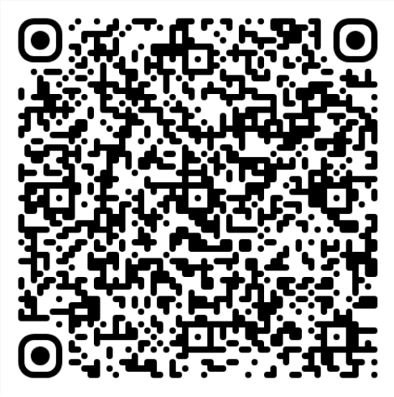
Large image slide
Register to vote here
FUNKY TUNES

Slide 10

So I’ve registered to vote, what next?
Now that you have registered, you can choose if you want to vote in an election, and who you want to vote for. Your vote is private and is your choice alone.
When an election is announced, political parties will campaign, which means they will send out messaging about their position on various issues. You may receive leaflets in the mail, see articles in newspapers or online, or watch party political broadcasts on TV.
There will likely be lots of online discussion too, and it is important to get your information from reputable sources, e.g. the Electoral Commission.
Be aware that AI technology means that it is easy to create a picture or video which may not be real, using only a prompt. If an image or video elicits a strong response for you, e.g. anger or disgust, take a moment to ask yourself why the poster wants you to feel that way, and try to verify the source.

Slide 11

Can you spot AI?
Look at the images below and see if you can spot which ones are AI generated.

Slide 12
Can you spot AI?
Look at the images below and see if you can spot which ones are AI generated.
All four images are AI generated.
Be careful which sources you use for information in the lead up to elections.
AI
AI
AI
AI

Slide 13
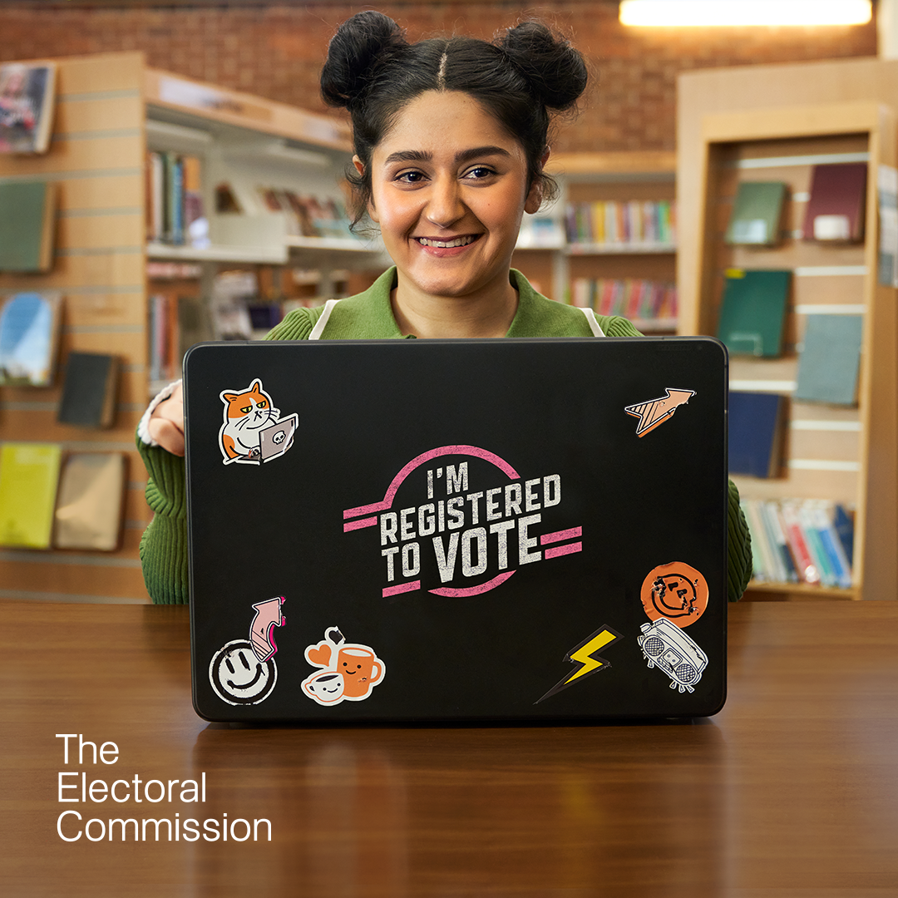

Video slide
Email registration@centralscotland-vjb.gov.uk
By phone on 01786 892289
Insta @erocentral
Youtube @CS_ERO
Contact us & follow our socials

Slide 14



Thank You
FUNKY TUNES
Launch
Launch
BOFFIN
Electoral Registration Office
For Falkirk Stirling and Clackmannanshire

