Slide 1

are you ready to vote?

Slide 2
Welcome
Who are we?
How does democracy work in Scotland?
Why should I register to vote?
Who can register to vote?
How do I register to vote?
What voting methods can I choose?

Slide 3
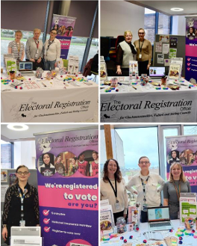

We are from the Electoral Registration Office for Clackmannanshire, Falkirk, and Stirling Councils. We maintain the electoral register for the 3 council areas, and deal with registering to vote and voting methods.

Slide 4
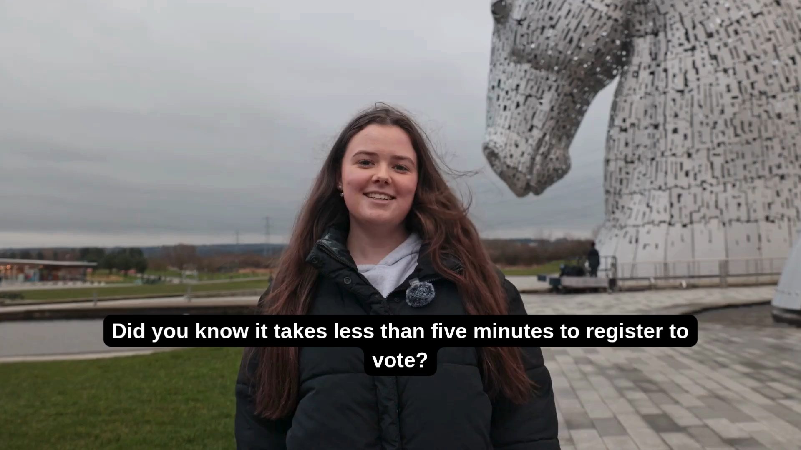

Slide 5

How does Democracy work in Scotland?
Scotland is part of the UK, which has a Parliament in London.
Since 1999, Scotland has also had its own parliament, based in Holyrood in Edinburgh.
Decisions about some aspects of life in Scotland were transferred from the UK parliament to the Scottish Parliament in a process called devolution. The UK Parliament is still responsible for some decisions for the whole of the UK.
Your local council has the responsibility of making some decisions about local matters.

Slide 6
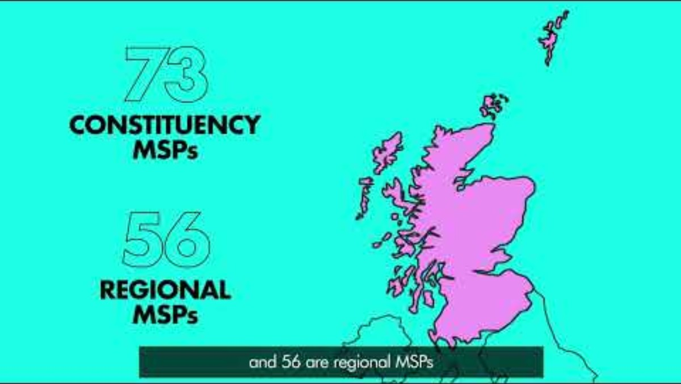
This year there is a Scottish Parliamentary Election on the 7th of May

Slide 7

Why register to vote?
You can have your say on things that matter to you.
You can vote for someone who represents you.
You then have the choice to vote or not every time.
Being on the register can improve your credit rating.

Slide 8

Who can register to vote?
Anyone who is aged 14 or over.
Anyone who lives in Scotland, regardless of Nationality.
If you fit this criteria, you can register to vote, but different types of elections have different rules regarding who can vote.

Slide 9


Scottish Parliamentary Election 07/05/2026

Slide 10

How do I register to vote?
You can register
Online at www.gov.uk/register-to-vote or scan the QR code;
Call us on 01786 892289;
Call us on the same number using the Contact Scotland BSL app or website;
Visit our office at Ground Floor Right, Glendevon House, The Castle Business Park, Stirling FK9 4TZ
Complete a paper form with us today!
Forms are also available on request in other formats including large print, braille, and select languages.

Slide 11
What do I need to register to vote?
You only need to answer a few questions and provide your National Insurance number. If you don’t have a National Insurance number, we can use a form of photographic ID to confirm your identity e.g. passport or driving license.
If you have lost your National Insurance number, you can contact their hotline on 0300 200 3500. Lines are open Monday to Friday 8am to 8pm and Saturday 8am to 4pm.
You can normally find your National Insurance number on wage slips, or letters about benefits or pensions.

Slide 12

What voting methods can I choose?

Slide 13
Thank you!
Don’t forget to follow our socials to keep up with the latest news!
Email registration@centralscotland-vjb.gov.uk
By phone on 01786 892289

